Slide 1
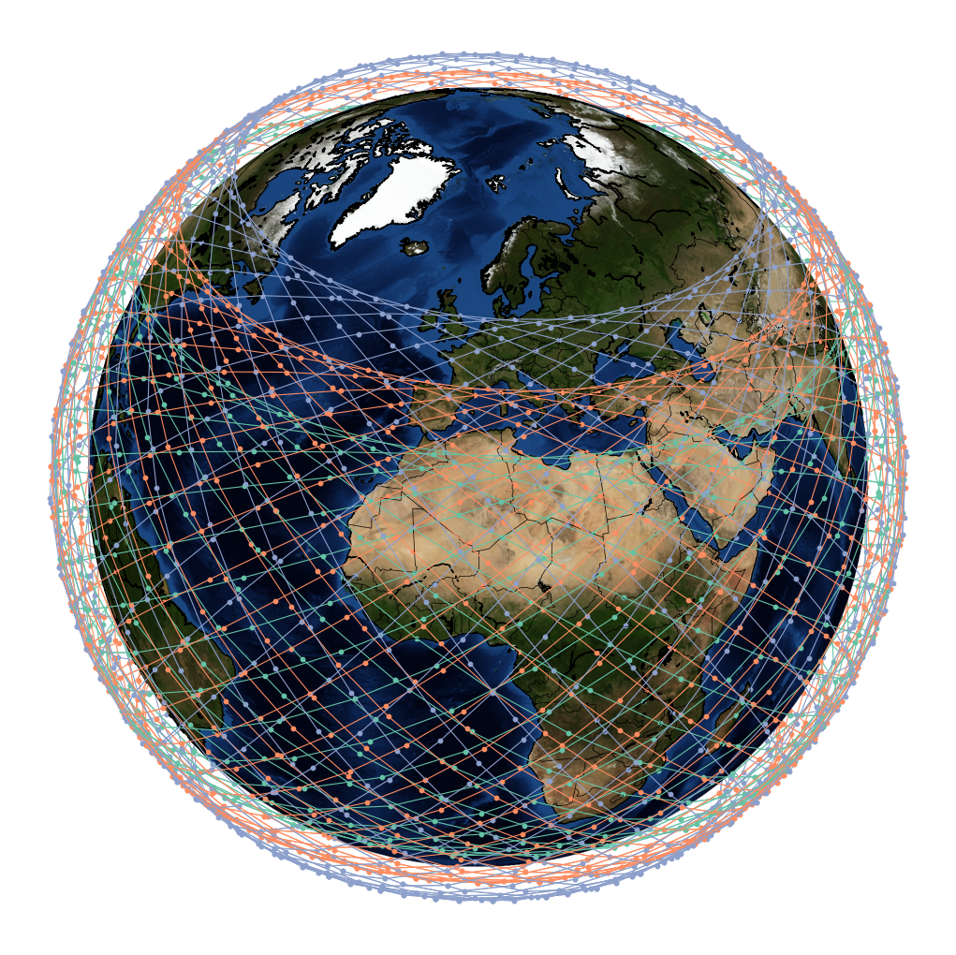
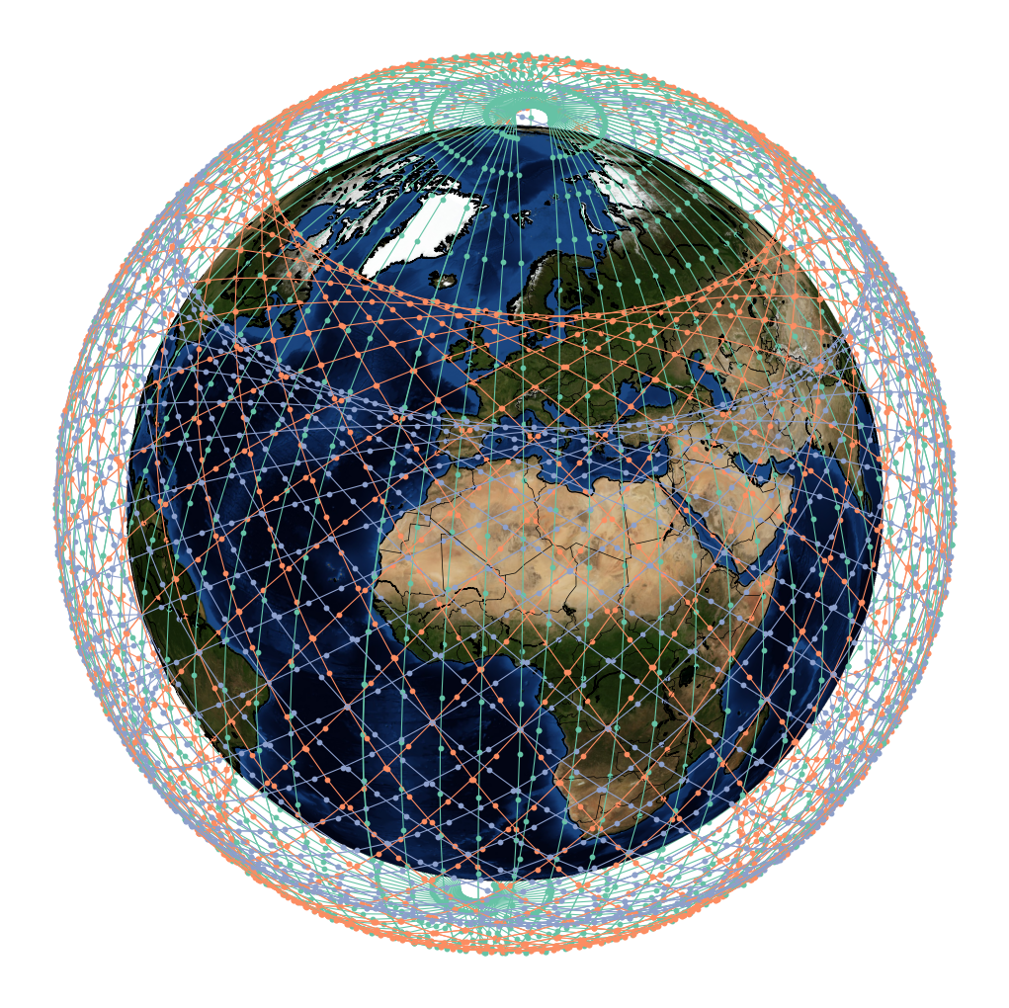
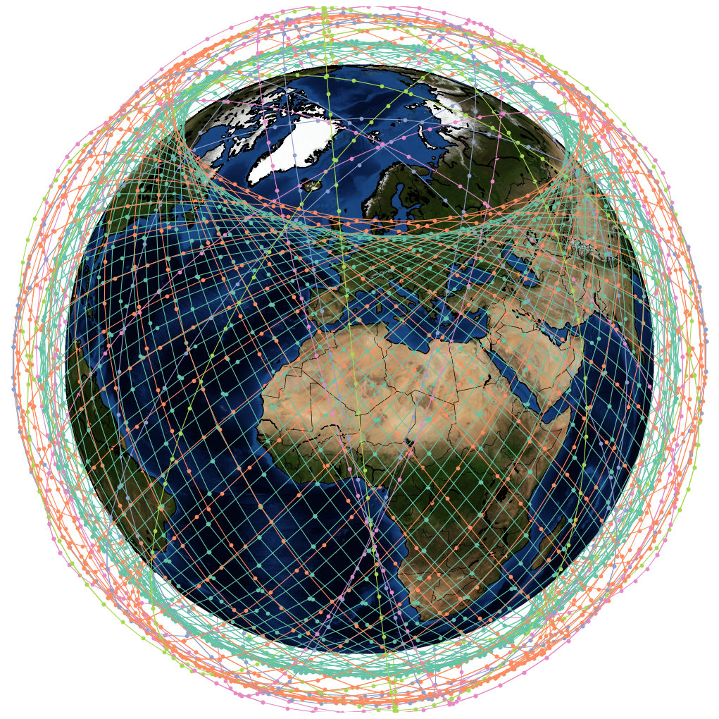
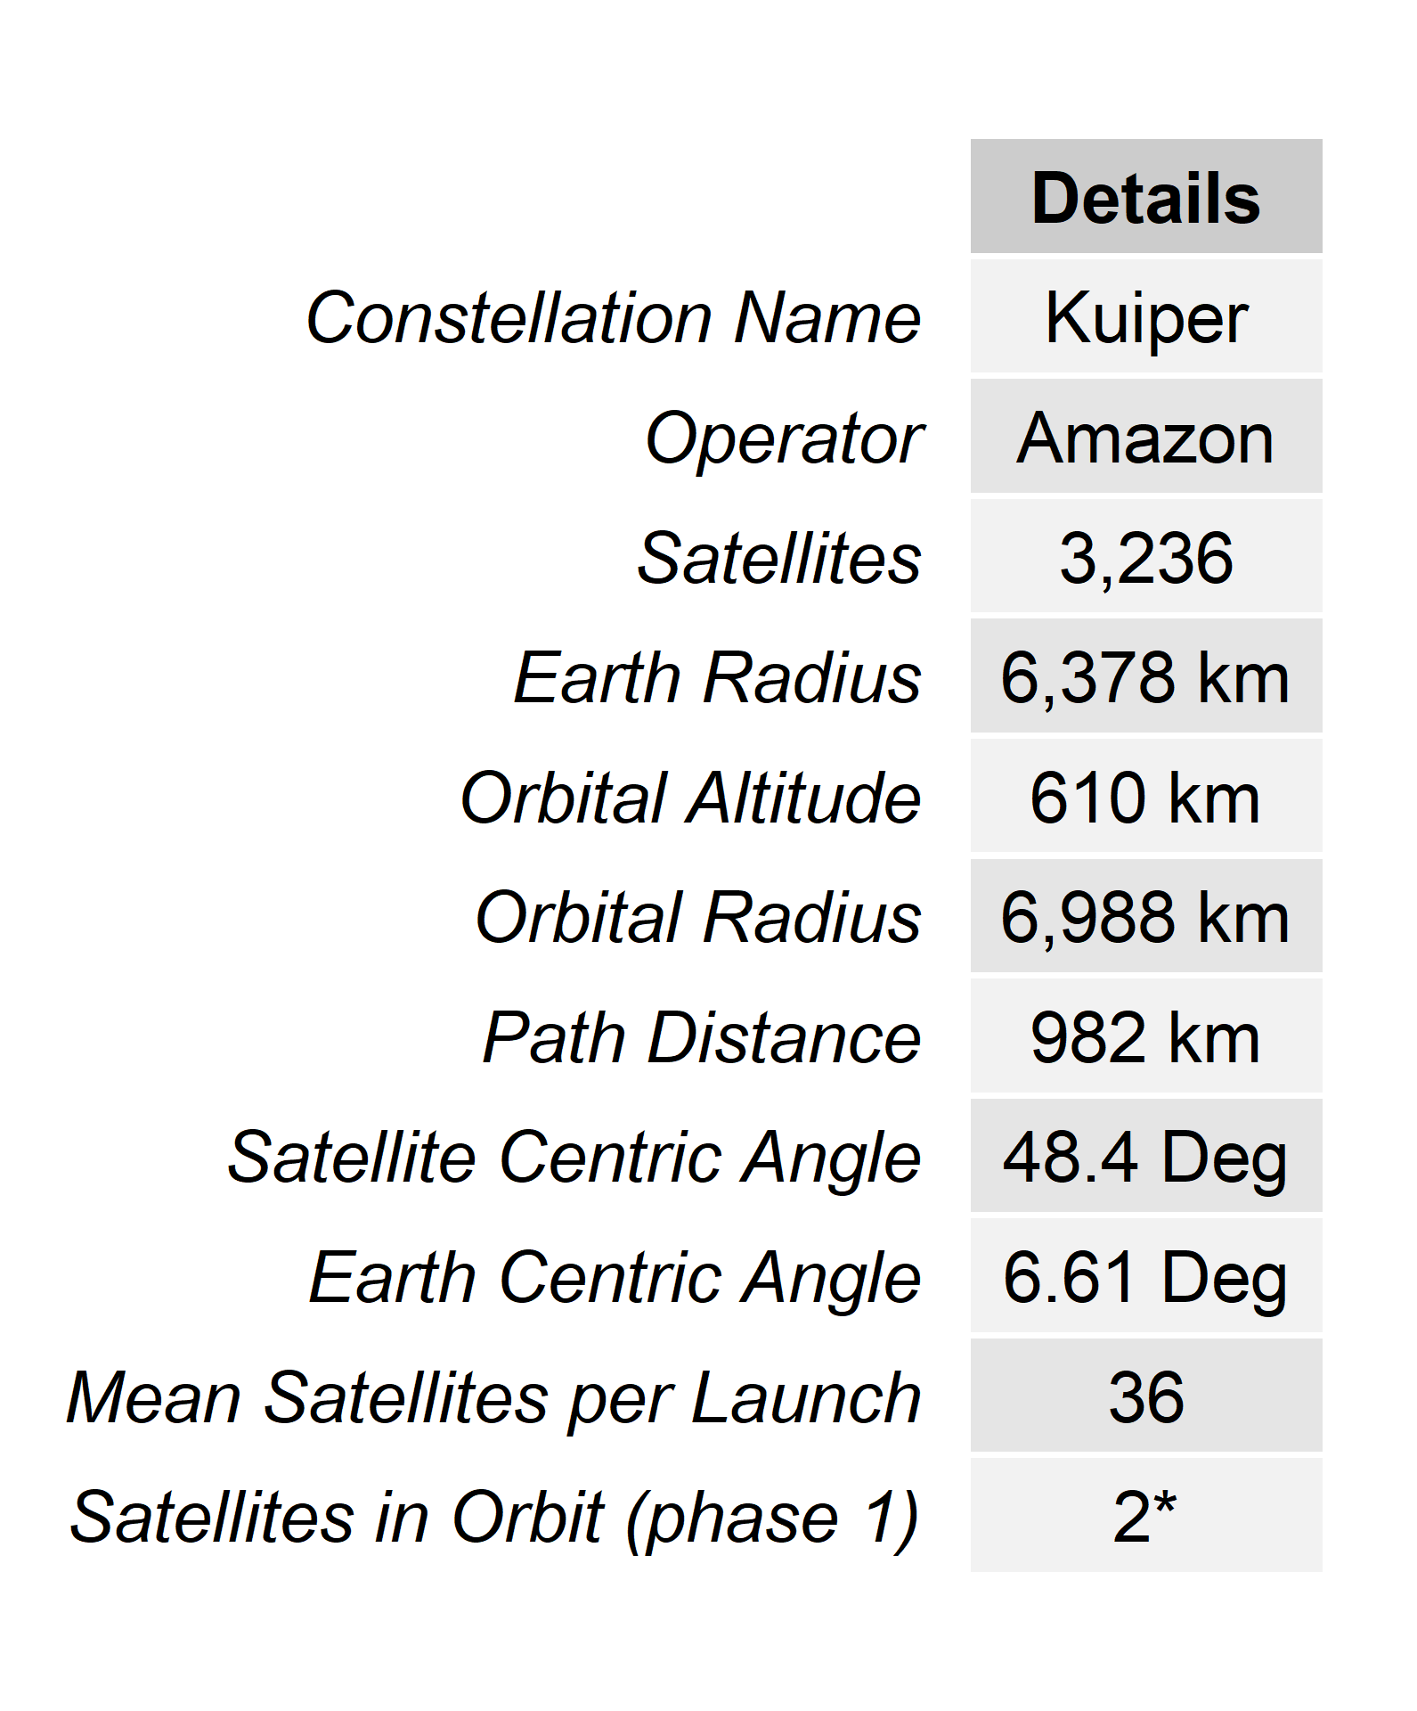
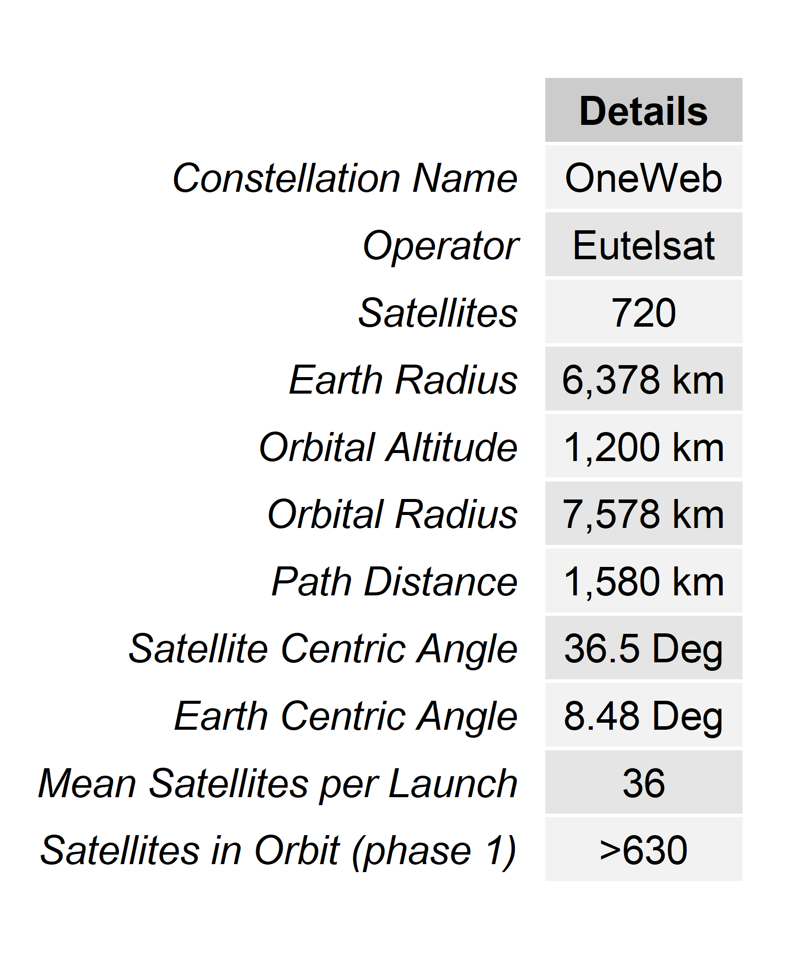
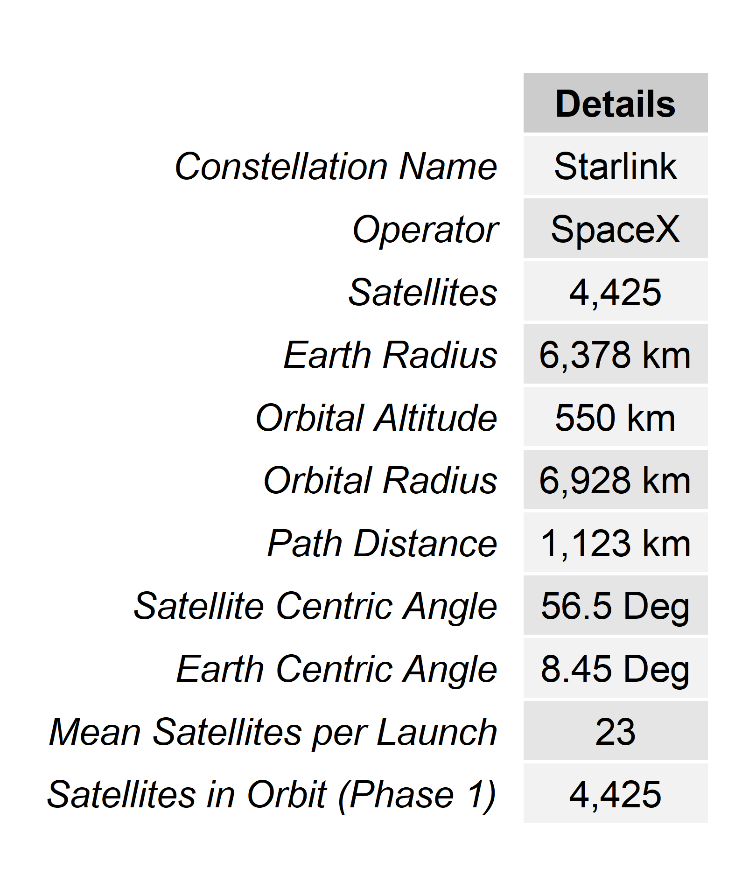
a
b
c
d
e
f

Slide 2
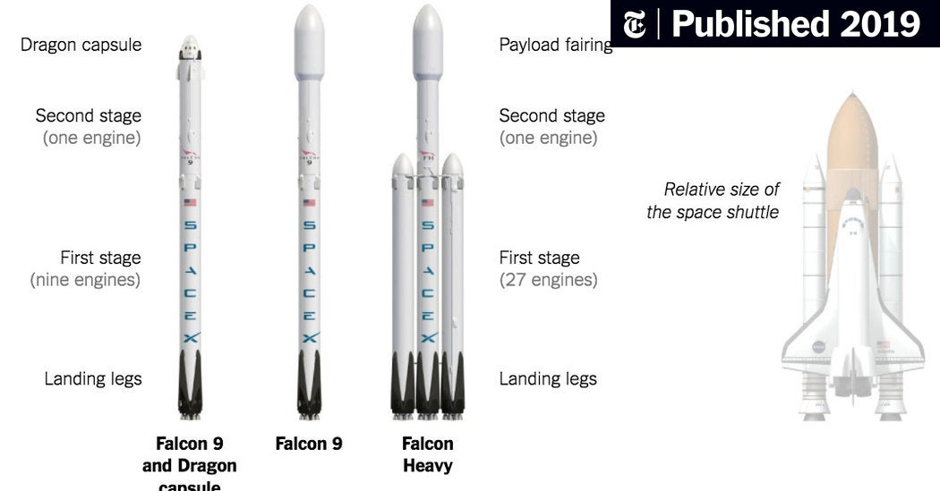
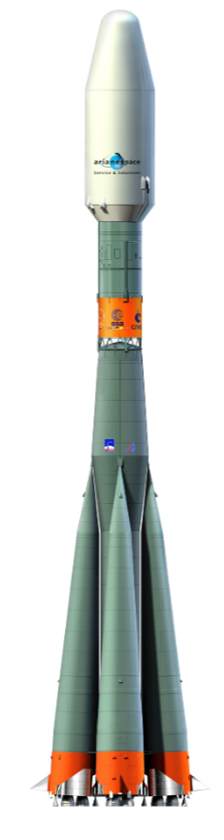
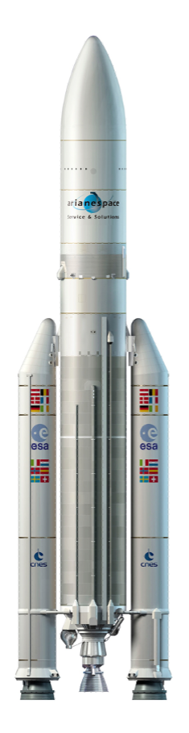
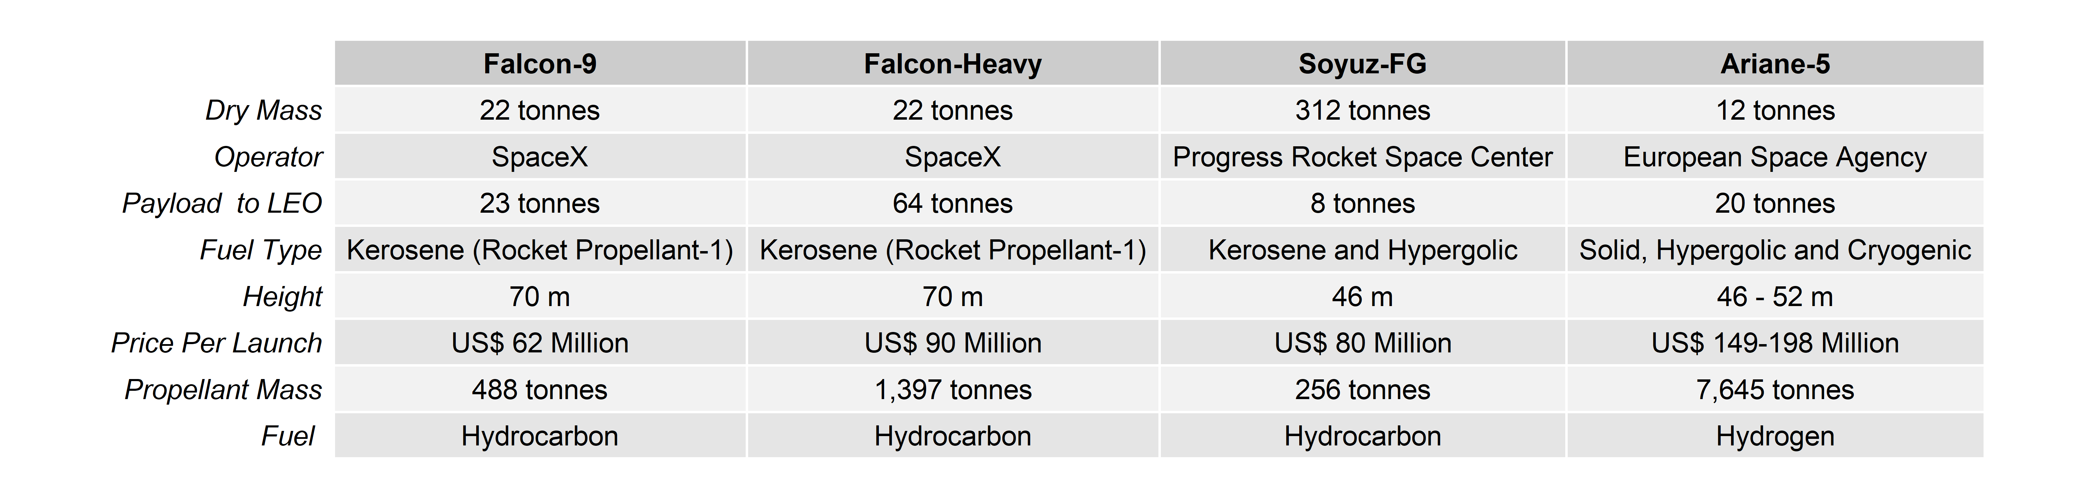

Slide 3
Production of Propellant
Launcher Production & Development
Transportation of Launcher
Minimum Elevation Angle
Path Loss
Orbital Altitude
Lifecycle Management of Propellant
Launch Campaign
Launcher Assembly and Testing
Link Budget
Launch Event
Channel Capacity
Satellite Capacity
Number of Satellites
Total Constellation Emissions
Total Usable Constellation Capacity
LCIA Model
Capacity Model
LEO Sustainability Analytics
Emissions
Capacity
Demand
Costs
Demand Model
Cost Model
Active User Density (Users/km²)
Assessment Period
(Years)
Total Cost of Ownership (TCO) ($US)
Discount
Rate (%)
Active Users (%)
Population Density (Pop/km2)
Capital Expenditure
Operational Expenditure
Manufacture
Fiber Infra-structure
Maintenance
Regulatory Fees
Rocket Launches
Ground Stations
Staff
Customer Acquisition
Adoption Rate (%)
Market Share (%)
Admin Area (km²)
Population Data
Energy

Slide 4
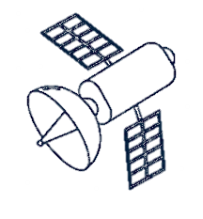




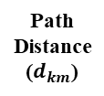

Satellite Orbit
$$β$$
Orbital altitude (h)
Path
Distance
($d_{km}$)
Subsatellite point
$$ε_{min}$$
User Terminal
$$φ$$
Earth Radius ($R_{E}$)
Earth Center

